Slide 1

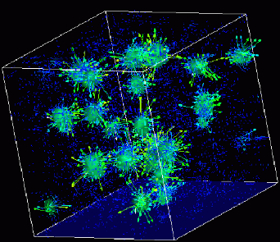
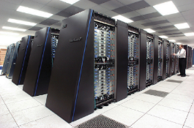
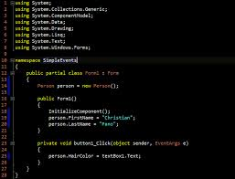
Advanced
Scientific Computing
(SciComp 201)
Session 34
Fourier Analysis

Slide 2
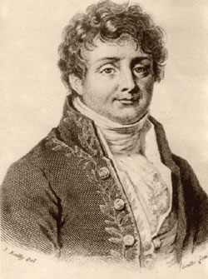
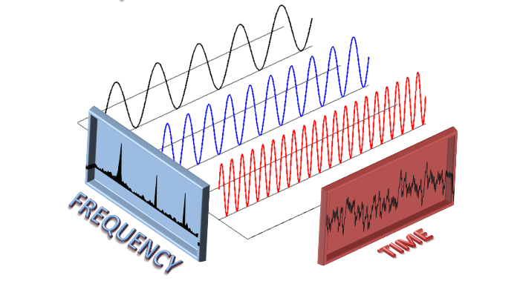
Fourier Transform
Continuous and Discrete
Jean-Baptiste Fourier (1768-1830)
both r’s are silent
“Foo-yeah”

Slide 3
All of Physics is Waves
Electrical
Magnetic
Acoustic
Heat Flow
Vibrational
Torsional
Nuclear / Quantum
Gravitational
Oceanic / Tidal
Orbital Precession
Springs
Pendulums
Tomography Reconstruction
Stock Market
Economics
Astronomical
Fluid Dynamics
Earthquakes
AC / DC
AM / FM
Speech
Heartbeats
What often appears to be random motion in nature is often the superposition of very regular waveforms – but which ones?

Slide 4
Continuous Fourier Transform (CFT)
$$θ=2πnft$$
$$f=\frac{1}{2π}$$
$$y\left(t\right)=\sum_{n=0}^{∞}{\left[A_{n}\cos\left(nt\right)+B_{n}\sin\left(nt\right)\right]}$$
$$0 ≤t <2π$$
Most periodic waveforms are a linear sum of other waveforms each with a frequency that is an integral multiple of the fundamental frequency.
$$y\left(t\right)=time domain$$
$$t, A_{n}, B_{n}∈ℝ$$
$$n,k∈ℤ^{∗} \left(≥0\right)$$
$$y has a unit period$$
$$\int_{0}^{2π}{y(t)\cos\left(kt\right)dt}=\sum_{n=0}^{∞}{\left[A_{n}\int_{0}^{2π}{\cos\left(kt\right)\cos\left(nt\right)dt+B_{n}\int_{0}^{2π}{\cos\left(kt\right)\sin\left(nt\right)dt}}\right]}$$
Eq. A
$$\int_{0}^{2π}{y(t)\sin\left(kt\right)dt}=\sum_{n=0}^{∞}{\left[A_{n}\int_{0}^{2π}{\sin\left(kt\right)\cos\left(nt\right)dt+B_{n}\int_{0}^{2π}{\sin\left(kt\right)\sin\left(nt\right)dt}}\right]}$$
Eq. B
To find A and B coefficients, multiply both sides by $\cos{(kt)}$ and $\sin{(kt)}$ and integrate from $0 to 2π$
Integral of Sums = Sum of Integrals

Slide 5
Eq. A
Eq. A1
Eq. A2
$$\int_{0}^{2π}{y(t)\cos\left(kt\right)dt}=\sum_{n=0}^{∞}{\left[A_{n}\int_{0}^{2π}{\cos\left(kt\right)\cos\left(nt\right)dt+B_{n}\int_{0}^{2π}{\cos\left(kt\right)\sin\left(nt\right)dt}}\right]}$$
$$\cos\left(α\right)\cos\left(β\right)=\frac{1}{2}\left(\cos{(α+β}\right)+\cos{(α−β))}$$
$$α=kt, β=nt$$
$$\int_{0}^{2π}{\cos{(kt)\cos\left(nt\right)dt}=}\frac{1}{2}\int_{0}^{2π}{\cos\left(\left(k+n\right)t\right)dt}+\frac{1}{2}\int_{0}^{2π}{\cos\left(\left(k−n\right)t\right)dt}$$
$$u=\left(k+n\right)t ⇒du=\left(k+n\right)dt$$
Eq. A1a
$$\frac{1}{2(k+n)}\int_{0}^{2π(k+n)}{\cos\left(u\right)du}=\frac{\sin\left(u\right)}{2(k+n)}\left|{2π(k+n) \atop u=0}\right.=\frac{\sin\left(2π\left(k+n\right)\right)}{2\left(k+n\right)}$$
$$u=\left(k−n\right)t ⇒du=\left(k−n\right)dt$$
Eq. A1b
$$\frac{1}{2(k−n)}\int_{0}^{2π(k−n)}{\cos\left(u\right)du}=\frac{\sin\left(u\right)}{2(k−n)}\left|{2π(k−n) \atop u=0}\right.=\frac{\sin\left(2π\left(k−n\right)\right)}{2\left(k−n\right)}$$

Slide 6
Eq. A
Eq. A1
Eq. A2
$$\int_{0}^{2π}{y(t)\cos\left(kt\right)dt}=\sum_{n=0}^{∞}{\left[A_{n}\int_{0}^{2π}{\cos\left(kt\right)\cos\left(nt\right)dt+B_{n}\int_{0}^{2π}{\cos\left(kt\right)\sin\left(nt\right)dt}}\right]}$$
Numerators are always 0
$$n,k∈ℤ^{∗}$$
Eq. A1a
Eq. A1b
$$\int_{0}^{2π}{\cos{(kt)\cos\left(nt\right)dt}=\frac{\sin\left(2π\left(k+n\right)\right)}{2\left(k+n\right)}+}\frac{\sin\left(2π\left(k−n\right)\right)}{2\left(k−n\right)}$$
Eq. A1
$k≠n$
$\left(k=n\right)=0$
$\left(k=n\right)≠0$
But what happens here when n = k = 0?
$$\lim_{k→n}{\frac{\sin\left(2π\left(k+n\right)\right)}{2\left(k+n\right)}}=\frac{\sin\left(4πn\right)}{4n}$$
Eq. A1a
$$\text{L}\text{′}\text{H}\text{ô}\text{pital}\text{′}\text{s} \text{rule}$$
$$\lim_{n→0}{\frac{\sin\left(4πn\right)}{4n}=\frac{1}{4}\left(\lim_{n→0}{\frac{\sin\left(4πn\right)}{n}}\right)=\frac{1}{4}\left(\lim_{n→0}{\frac{4π\cos\left(4πn\right)}{1}}\right)=π}$$

Slide 7
Eq. A
Eq. A1
Eq. A2
$$\int_{0}^{2π}{y(t)\cos\left(kt\right)dt}=\sum_{n=0}^{∞}{\left[A_{n}\int_{0}^{2π}{\cos\left(kt\right)\cos\left(nt\right)dt+B_{n}\int_{0}^{2π}{\cos\left(kt\right)\sin\left(nt\right)dt}}\right]}$$
Eq. A1a
Eq. A1b
$$\int_{0}^{2π}{\cos{(kt)\cos\left(nt\right)dt}=\frac{\sin\left(2π\left(k+n\right)\right)}{2\left(k+n\right)}+}\frac{\sin\left(2π\left(k−n\right)\right)}{2\left(k−n\right)}$$
Eq. A1
But what happens here when n = k?
$$\text{L}\text{′}\text{H}\text{ô}\text{pital}\text{′}\text{s} \text{rule}$$
Eq. A1b
$$\lim_{k→n}{\frac{\sin\left(2π\left(k−n\right)\right)}{2\left(k−n\right)}}=\frac{1}{2}\lim_{k→n}{\frac{\frac{d}{dk}\sin\left(2π\left(k−n\right)\right)}{\frac{d}{dk}\left(k−n\right)}=\frac{1}{2}\lim_{k→n}{\frac{2π\cos\left(2π\left(k−n\right)\right)}{1}}}$$
$$π\left(\lim_{k→n}{\cos\left(2π\left(k−n\right)\right)}\right)=π\left(\cos{0}\right)=π$$

Slide 8
Eq. A
Eq. A1
Eq. A2
$$\int_{0}^{2π}{y(t)\cos\left(kt\right)dt}=\sum_{n=0}^{∞}{\left[A_{n}\int_{0}^{2π}{\cos\left(kt\right)\cos\left(nt\right)dt+B_{n}\int_{0}^{2π}{\cos\left(kt\right)\sin\left(nt\right)dt}}\right]}$$
$$\sin\left(α\right)\cos\left(β\right)=\frac{1}{2}\left(\sin{(α+β}\right)+\sin{(α−β))}$$
$$α=nt, β=kt$$
Eq. A2
$$\int_{0}^{2π}{\cos{(kt)\sin\left(nt\right)dt}=}\frac{1}{2}\int_{0}^{2π}{\sin\left(\left(k+n\right)t\right)dt}−\frac{1}{2}\int_{0}^{2π}{\sin\left(\left(k−n\right)t\right)dt}$$
$$u=\left(k+n\right)t ⇒du=\left(k+n\right)dt$$
Eq. A2a
$$\frac{1}{2(k+n)}\int_{0}^{2π(k+n)}{\sin\left(u\right)du}=\frac{−cos\left(u\right)}{2(k+n)}\left|{2π(k+n) \atop u=0}\right.=\frac{\sin^{2}\left(π\left(k+n\right)\right)}{\left(k+n\right)}$$
$$u=\left(k−n\right)t ⇒du=\left(k−n\right)dt$$
Eq. A2b
$$\frac{1}{2(k−n)}\int_{0}^{2π(k−n)}{\sin\left(u\right)du}=\frac{\cos\left(u\right)}{2(k−n)}\left|{2π(k−n) \atop u=0}\right.=\frac{−\sin^{2}\left(π\left(k−n\right)\right){ }}{\left(k−n\right)}$$

Slide 9
Eq. A
Eq. A1
Eq. A2
$$\int_{0}^{2π}{y(t)\cos\left(kt\right)dt}=\sum_{n=0}^{∞}{\left[A_{n}\int_{0}^{2π}{\cos\left(kt\right)\cos\left(nt\right)dt+B_{n}\int_{0}^{2π}{\cos\left(kt\right)\sin\left(nt\right)dt}}\right]}$$
Numerators always 0
$$n,k∈ℤ^{∗}$$
Eq. A2a
Eq. A2b
$$\int_{0}^{2π}{\cos{(kt)\sin\left(nt\right)dt}=\frac{\sin^{2}\left(π\left(k+n\right)\right)}{\left(k+n\right)}−}\frac{\sin^{2}\left(π\left(k−n\right)\right){ }}{\left(k−n\right)}$$
Eq. A2
But what happens here when n = k = 0?
$$\text{L}\text{′}\text{H}\text{ô}\text{pital}\text{′}\text{s} \text{rule}$$
Eq. A2a
$$\lim_{k→n}{\frac{\sin^{2}\left(π\left(k+n\right)\right)}{\left(k+n\right)}=\frac{\sin^{2}\left(2πn\right)}{2n}}$$
$$\lim_{n→0}{\frac{\sin^{2}\left(2πn\right)}{2n}=0}$$

Slide 10
Eq. A
Eq. A1
Eq. A2
$$\int_{0}^{2π}{y(t)\cos\left(kt\right)dt}=\sum_{n=0}^{∞}{\left[A_{n}\int_{0}^{2π}{\cos\left(kt\right)\cos\left(nt\right)dt+B_{n}\int_{0}^{2π}{\cos\left(kt\right)\sin\left(nt\right)dt}}\right]}$$
Eq. A2a
Eq. A2b
$$\int_{0}^{2π}{\cos{(kt)\sin\left(nt\right)dt}=\frac{\sin^{2}\left(π\left(k+n\right)\right)}{\left(k+n\right)}−}\frac{\sin^{2}\left(π\left(k−n\right)\right){ }}{\left(k−n\right)}$$
Eq. A2
But what happens here when n = k?
$$\text{L}\text{′}\text{H}\text{ô}\text{pital}\text{′}\text{s} \text{rule}$$
Eq. A2b
$$\lim_{k→n}{\frac{\sin^{2}\left(π\left(k−n\right)\right){ }}{\left(k−n\right)}=}\lim_{k→n}{\frac{\frac{d}{dk}\sin^{2}\left(π\left(k−n\right)\right)}{\frac{d}{dk}\left(k−n\right)}}=\lim_{k→n}{\frac{2π\sin\left(π\left(k−n\right)\right)\cos\left(π\left(k−n\right)\right)}{1}}$$
$$\lim_{k→n}{π\sin\left(2π\left(k−n\right)\right)=0}$$

Slide 11
Eq. A
Eq. A1
Eq. A2
$$\int_{0}^{2π}{y(t)\cos\left(kt\right)dt}=\sum_{n=0}^{∞}{\left[A_{n}\int_{0}^{2π}{\cos\left(kt\right)\cos\left(nt\right)dt+B_{n}\int_{0}^{2π}{\cos\left(kt\right)\sin\left(nt\right)dt}}\right]}$$
$$\int_{0}^{2π}{\cos{(kt)\cos\left(nt\right)dt}=}$$
$$0 when n≠k$$
Eq. A1
Eq. A1
$$π when n=k$$
Eq. A1b
$$2π when n=k=0$$
Eq. A1a
$$\int_{0}^{2π}{\cos{(kt)\sin\left(nt\right)dt}=}$$
$$0 when n≠k$$
Eq. A2
Eq. A2
$$0 when n=k$$
Eq. A2b
$$All B_{n} vanish$$
$$0 when n=k=0$$
Eq. A2a
$$A_{0}=\frac{1}{2π}\int_{0}^{2π}{y\left(t\right)dt}$$
Eq. A1a
$$k=0→\cos\left(0t\right)=1$$
$$A_{n}=\frac{1}{π}\int_{0}^{2π}{y\left(t\right)\cos\left(kt\right)dt}$$
$$n=number of terms$$
$$k=1,2,3,…n$$
Eq. A1b

Slide 12
Eq. B
Eq. B1
Eq. B2
$$\int_{0}^{2π}{y(t)\sin\left(kt\right)dt}=\sum_{n=0}^{∞}{\left[A_{n}\int_{0}^{2π}{\sin\left(kt\right)\cos\left(nt\right)dt+B_{n}\int_{0}^{2π}{\sin\left(kt\right)\sin\left(nt\right)dt}}\right]}$$
$$\sin\left(α\right)\cos\left(β\right)=\frac{1}{2}\left(\sin{(α+β}\right)+\sin{(α−β))}$$
$$α=kt, β=nt$$
Eq. B1
$$\int_{0}^{2π}{\sin{(kt)\cos\left(nt\right)dt}=}\frac{1}{2}\int_{0}^{2π}{\sin\left(\left(k+n\right)t\right)dt}+\frac{1}{2}\int_{0}^{2π}{\sin\left(\left(k−n\right)t\right)dt}$$
$$u=\left(k+n\right)t ⇒du=\left(k+n\right)dt$$
Eq. B1a
$$\frac{1}{2(k+n)}\int_{0}^{2π(k+n)}{\sin\left(u\right)du}=−\frac{\cos\left(u\right)}{2(k+n)}\left|{2π(k+n) \atop u=0}\right.=\frac{\sin^{2}\left(π\left(k+n\right)\right)}{\left(k+n\right)}$$
$$u=\left(k−n\right)t ⇒du=\left(k−n\right)dt$$
Eq. B1b
$$\frac{1}{2(k−n)}\int_{0}^{2π(k−n)}{\sin\left(u\right)du}=−\frac{\cos\left(u\right)}{2(k−n)}\left|{2π(k−n) \atop u=0}\right.=\frac{\sin^{2}\left(π\left(k−n\right)\right)}{\left(k−n\right)}$$

Slide 13
Eq. B
Eq. B1
Eq. B2
$$\int_{0}^{2π}{y(t)\sin\left(kt\right)dt}=\sum_{n=0}^{∞}{\left[A_{n}\int_{0}^{2π}{\sin\left(kt\right)\cos\left(nt\right)dt+B_{n}\int_{0}^{2π}{\sin\left(kt\right)\sin\left(nt\right)dt}}\right]}$$
Numerators are always 0
Eq. B1a
Eq. B1b
$$\int_{0}^{2π}{\sin{(kt)\cos\left(nt\right)dt}=\frac{\sin^{2}\left(π\left(k+n\right)\right)}{\left(k+n\right)}+\frac{\sin^{2}\left(π\left(k−n\right)\right)}{\left(k−n\right)}}$$
Eq. B1
But what happens here when n = k = 0?
$$\text{L}\text{′}\text{H}\text{ô}\text{pital}\text{′}\text{s} \text{rule}$$
$k≠n$
$\left(k=n\right)=0$
$\left(k=n\right)≠0$
Eq. B1a
$$\lim_{k→n}{\frac{\sin^{2}\left(π\left(k+n\right)\right)}{\left(k+n\right)}=\frac{\sin^{2}\left(2πn\right)}{2n}}$$
$$\lim_{n→0}{\frac{\sin^{2}\left(2πn\right)}{2n}=0}$$

Slide 14
Eq. B
Eq. B1
Eq. B2
$$\int_{0}^{2π}{y(t)\sin\left(kt\right)dt}=\sum_{n=0}^{∞}{\left[A_{n}\int_{0}^{2π}{\sin\left(kt\right)\cos\left(nt\right)dt+B_{n}\int_{0}^{2π}{\sin\left(kt\right)\sin\left(nt\right)dt}}\right]}$$
Eq. B1a
Eq. B1b
$$\int_{0}^{2π}{\sin{(kt)\cos\left(nt\right)dt}=\frac{\sin^{2}\left(π\left(k+n\right)\right)}{\left(k+n\right)}+\frac{\sin^{2}\left(π\left(k−n\right)\right)}{\left(k−n\right)}}$$
Eq. B1
But what happens here when n = k?
$$\text{L}\text{′}\text{H}\text{ô}\text{pital}\text{′}\text{s} \text{rule}$$
Eq. B1b
$$\lim_{k→n}{\frac{\sin^{2}\left(π\left(k−n\right)\right){ }}{\left(k−n\right)}=}\lim_{k→n}{\frac{\frac{d}{dk}\sin^{2}\left(π\left(k−n\right)\right)}{\frac{d}{dk}\left(k−n\right)}}=\lim_{k→n}{\frac{2π\sin\left(π\left(k−n\right)\right)\cos\left(π\left(k−n\right)\right)}{1}}$$
$$\lim_{k→n}{π\sin\left(2π\left(k−n\right)\right)=0}$$

Slide 15
Eq. B
Eq. B1
Eq. B2
$$\int_{0}^{2π}{y(t)\sin\left(kt\right)dt}=\sum_{n=0}^{∞}{\left[A_{n}\int_{0}^{2π}{\sin\left(kt\right)\cos\left(nt\right)dt+B_{n}\int_{0}^{2π}{\sin\left(kt\right)\sin\left(nt\right)dt}}\right]}$$
$$\sin\left(α\right)\sin\left(β\right)=\frac{1}{2}\left(\cos{(α−β}\right)−\cos{(α+β))}$$
$$α=kt, β=nt$$
$$\int_{0}^{2π}{\sin{(kt)\sin\left(nt\right)dt}=}\frac{1}{2}\int_{0}^{2π}{\cos\left(\left(k−n\right)t\right)dt}−\frac{1}{2}\int_{0}^{2π}{\cos\left(\left(k+n\right)t\right)dt}$$
Eq. B2
$$u=\left(k−n\right)t ⇒du=\left(k−n\right)dt$$
Eq. B2a
$$\frac{1}{2(k−n)}\int_{0}^{2π(k−n)}{\cos\left(u\right)du}=\frac{\sin\left(u\right)}{2(k−n)}\left|{2π(k−n) \atop u=0}\right.=\frac{\sin\left(2π\left(k−n\right)\right)}{2\left(k−n\right)}$$
$$u=\left(k+n\right)t ⇒du=\left(k+n\right)dt$$
Eq. B2b
$$\frac{1}{2(k+n)}\int_{0}^{2π(k+n)}{\sin\left(u\right)du}=−\frac{\sin\left(u\right)}{2\left(k+n\right)}\left|{2π\left(k+n\right) \atop u=0}\right.=−\frac{\sin\left(2π\left(k+n\right)\right)}{2\left(k+n\right)}$$

Slide 16
Eq. B
Eq. B1
Eq. B2
$$\int_{0}^{2π}{y(t)\sin\left(kt\right)dt}=\sum_{n=0}^{∞}{\left[A_{n}\int_{0}^{2π}{\sin\left(kt\right)\cos\left(nt\right)dt+B_{n}\int_{0}^{2π}{\sin\left(kt\right)\sin\left(nt\right)dt}}\right]}$$
Numerators are always 0
Eq. B2a
Eq. B2b
$$\int_{0}^{2π}{\sin{(kt)\sin\left(nt\right)dt}=\frac{\sin\left(2π\left(k−n\right)\right)}{2\left(k−n\right)}−\frac{\sin\left(2π\left(k+n\right)\right)}{2\left(k+n\right)}}$$
Eq. B2
$k≠n$
$\left(k=n\right)=0$
$\left(k=n\right)≠0$
But what happens here when n = k = 0?
$$\lim_{k→n}{\frac{\sin\left(2π\left(k+n\right)\right)}{2\left(k+n\right)}}=\frac{\sin\left(4πn\right)}{4n}$$
Eq. B2b
$$\text{L}\text{′}\text{H}\text{ô}\text{pital}\text{′}\text{s} \text{rule}$$
$$\lim_{n→0}{\frac{\sin\left(4πn\right)}{4n}=\frac{1}{4}\left(\lim_{n→0}{\frac{\sin\left(4πn\right)}{n}}\right)=\frac{1}{4}\left(\lim_{n→0}{\frac{4π\cos\left(4πn\right)}{1}}\right)=π}$$

Slide 17
Eq. B
Eq. B1
Eq. B2
$$\int_{0}^{2π}{y(t)\sin\left(kt\right)dt}=\sum_{n=0}^{∞}{\left[A_{n}\int_{0}^{2π}{\sin\left(kt\right)\cos\left(nt\right)dt+B_{n}\int_{0}^{2π}{\sin\left(kt\right)\sin\left(nt\right)dt}}\right]}$$
Eq. B2a
Eq. B2b
$$\int_{0}^{2π}{\sin{(kt)\sin\left(nt\right)dt}=\frac{\sin\left(2π\left(k−n\right)\right)}{2\left(k−n\right)}−\frac{\sin\left(2π\left(k+n\right)\right)}{2\left(k+n\right)}}$$
Eq. B2
But what happens here when n = k?
Eq. B2a
$$\text{L}\text{′}\text{H}\text{ô}\text{pital}\text{′}\text{s} \text{rule}$$
$$\lim_{k→n}{\frac{\sin\left(2π\left(k−n\right)\right)}{2\left(k−n\right)}}=\frac{1}{2}\lim_{k→n}{\frac{\frac{d}{dk}\sin\left(2π\left(k−n\right)\right)}{\frac{d}{dk}\left(k−n\right)}=\frac{1}{2}\lim_{k→n}{\frac{2π\cos\left(2π\left(k−n\right)\right)}{1}}}$$
$$π\left(\lim_{k→n}{\cos\left(2π\left(k−n\right)\right)}\right)=π\left(\cos{0}\right)=π$$

Slide 18
Eq. B
Eq. B1
Eq. B2
$$\int_{0}^{2π}{y(t)\sin\left(kt\right)dt}=\sum_{n=0}^{∞}{\left[A_{n}\int_{0}^{2π}{\sin\left(kt\right)\cos\left(nt\right)dt+B_{n}\int_{0}^{2π}{\sin\left(kt\right)\sin\left(nt\right)dt}}\right]}$$
$$\int_{0}^{2π}{\sin{(kt)\cos\left(nt\right)dt}=}$$
$$0 when n≠k$$
Eq. B1
Eq. B1
$$0 when n=k$$
Eq. B1b
$$All A_{n} vanish$$
$$0 when n=k=0$$
Eq. B1a
$$\int_{0}^{2π}{\sin{(kt)\sin\left(nt\right)dt}=}$$
$$0 when n≠k$$
Eq. B2
Eq. B2
$$π when n=k$$
Eq. B2b
$$0 when n=k=0$$
Eq. B2a
Eq. B2a
$$B_{0}=\left(π−π\right)=0$$
$$B_{n}=\frac{1}{π}\int_{0}^{2π}{y\left(t\right)\sin\left(kt\right)dt}$$
$$n=number of terms$$
$$k=1,2,3,…n$$
Eq. B2b

Slide 19
Continuous Fourier Transform (CFT)
$$y\left(t\right)=\sum_{n=0}^{∞}{\left[A_{n}\cos\left(nt\right)+B_{n}\sin\left(nt\right)\right]}$$
$$θ=2πnft$$
$$f=\frac{1}{2π}$$
$$0 ≤t <2π$$
Most periodic waveforms are a linear sum of other waveforms each with a frequency that is an integral multiple of the fundamental frequency.
$$y\left(t\right)=time domain$$
$$t, A_{n}, B_{n}∈ℝ$$
$$n,k∈ℤ^{+}\left(≥0\right)$$
$$y has a unit period$$
$$A_{0}=\frac{1}{2π}\int_{0}^{2π}{y\left(t\right)dt}$$
$$A_{n}=\frac{1}{π}\int_{0}^{2π}{y\left(t\right)\cos\left(kt\right)dt}$$
$$n=number of terms$$
$$k=1,2,3,…n$$
$$B_{n}=\frac{1}{π}\int_{0}^{2π}{y\left(t\right)\sin\left(kt\right)dt}$$

Slide 20
Discrete Fourier Transform (DFT)
Eq. C
$∀ sample$ s
$$0≤s<samples$$
$$𝓎\left(t_{s}\right)≈\sum_{n=0}^{terms}{\left[A_{n}\cos\left(nt_{s}\right)+B_{n}\sin\left(nt_{s}\right)\right]}$$
$$t_{s}=\frac{2πs}{samples}$$
$$∀ term n$$
$$0≤n<terms$$
Eq. C1
$$\sum_{s=0}^{samples}{𝓎\left(t_{s}\right)\cos\left(nt_{s}\right)=A_{n}\sum_{s=0}^{samples}{\cos\left({nt}_{s}\right)\cos\left({nt}_{s}\right)}+B_{n}}\sum_{s=0}^{samples}{\cos\left(nt_{s}\right)\sin\left(nt_{s}\right)}$$
Eq. C2
$$\sum_{s=0}^{samples}{𝓎\left(t_{s}\right)\sin\left(nt_{s}\right)=A_{n}\sum_{s=0}^{samples}{\cos\left({nt}_{s}\right)\sin\left({nt}_{s}\right)}+B_{n}}\sum_{s=0}^{samples}{\sin\left(nt_{s}\right)\sin\left(nt_{s}\right)}$$

Slide 21
Discrete Fourier Transform (DFT)
$$\cos^{2}\left(n\right)=\frac{1+\cos\left(2n\right)}{2}$$
$$\cos\left(θ\right)\sin\left(θ\right)=\frac{\sin\left(2θ\right)}{2}$$
$$\sin^{2}\left(n\right)=\frac{1−\cos\left(2n\right)}{2}$$
Ident 3
$$\sum_{s=0}^{samples}{\frac{\sin\left(2θ\right)}{2}}=\frac{1}{2}\sum_{s=0}^{samples}{\sin\left(2n\right)}=0$$
$$\sum_{s=0}^{samples}{\cos\left(2n\right)}=\left\{\begin{matrix}samples, n=0 \\ 0, n≠0\end{matrix}\right.$$
Ident 1
$$\sum_{s=0}^{samples}{\cos^{2}\left(n\right)}=\frac{samples}{2}+\frac{1}{2}∗\left\{\begin{matrix}samples, n=0 \\ 0, n≠0\end{matrix}\right.$$
Ident 2
$$\sum_{s=0}^{samples}{\sin^{2}\left(n\right)}=\frac{samples}{2}−\frac{1}{2}∗\left\{\begin{matrix}samples, n=0 \\ 0, n≠0\end{matrix}\right.$$

Slide 22
Discrete Fourier Transform (DFT)
Eq. C1
$$\sum_{s=0}^{samples}{𝓎\left(t_{s}\right)\cos\left(nt_{s}\right)=A_{n}\sum_{s=0}^{samples}{\cos\left({nt}_{s}\right)\cos\left({nt}_{s}\right)}+B_{n}}\sum_{s=0}^{samples}{\cos\left(nt_{s}\right)\sin\left(nt_{s}\right)}$$
$$\sum_{s}^{samples}{\cos\left(nt_{s}\right)\cos\left(nt_{s}\right)=\left\{\begin{matrix}samples, n=0 \\ \\ \frac{samples}{2}, n >0\end{matrix}\right.}$$
Ident 1
$$n=0→\cos\left(nt_{s}\right)=1$$
$$\sum_{s}^{samples}{\cos\left(nt_{s}\right)\sin\left(nt_{s}\right)=0}$$
Ident 3
Eq. C1a
Eq. C1b
$$A_{0}=\frac{\sum_{s=0}^{samples}{𝓎\left(t_{s}\right)}}{samples}$$
$$A_{n}=\frac{2\sum_{s=0}^{samples}{𝓎\left(t_{s}\right)\cos\left(nt_{s}\right)}}{samples}$$

Slide 23
Discrete Fourier Transform (DFT)
Eq. C2
$$\sum_{s=0}^{samples}{𝓎\left(t_{s}\right)\sin\left(nt_{s}\right)=A_{n}\sum_{s=0}^{samples}{\cos\left({nt}_{s}\right)\sin\left({nt}_{s}\right)}+B_{n}}\sum_{s=0}^{samples}{\sin\left(nt_{s}\right)\sin\left(nt_{s}\right)}$$
$$\sum_{s}^{samples}{\cos\left(nt_{s}\right)\sin\left(nt_{s}\right)=0}$$
Ident 3
$$n=0→\sin\left(nt_{s}\right)=0$$
$$\sum_{s}^{samples}{\sin\left(nt_{s}\right)\sin\left(nt_{s}\right)=\left\{\begin{matrix} \\ \frac{samples}{2}, n >0\end{matrix}\right.}$$
Ident 2
Eq. C2a
Eq. C2b
$$B_{n}=\frac{2\sum_{s=0}^{samples}{𝓎\left(t_{s}\right)\sin\left(nt_{s}\right)}}{samples}$$
$$B_{0}=0$$

Slide 24
Discrete Fourier Transform (DFT)
Eq. C
$∀ sample$ s
$$0≤s<samples$$
$$𝓎\left(t_{s}\right)≈\sum_{n=0}^{terms}{\left[A_{n}\cos\left(nt_{s}\right)+B_{n}\sin\left(nt_{s}\right)\right]}$$
$$t_{s}=\frac{2πs}{samples}$$
$$∀ term n$$
$$0≤n<terms$$
$$A_{0}=\frac{\sum_{s=0}^{samples}{𝓎\left(t_{s}\right)}}{samples}$$
Eq. C1a
$$A_{n}=\frac{2\sum_{s=0}^{samples}{𝓎\left(t_{s}\right)\cos\left(nt_{s}\right)}}{samples}$$
Eq. C1b
$$B_{n}=\frac{2\sum_{s=0}^{samples}{𝓎\left(t_{s}\right)\sin\left(nt_{s}\right)}}{samples}$$
Eq. C2b

Slide 25
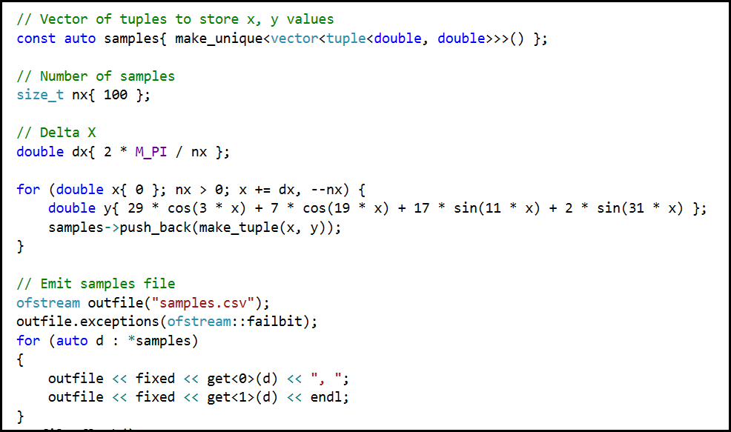
Lab 1 - Generate Samples for Waveform

Slide 26
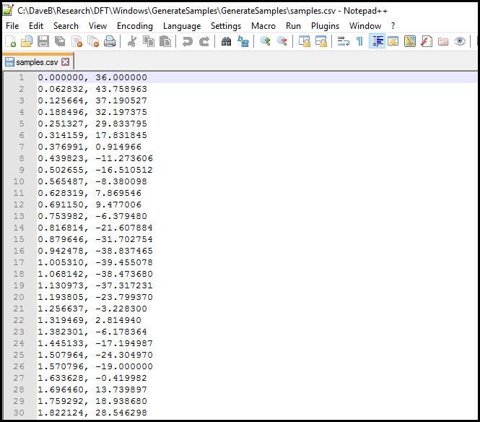
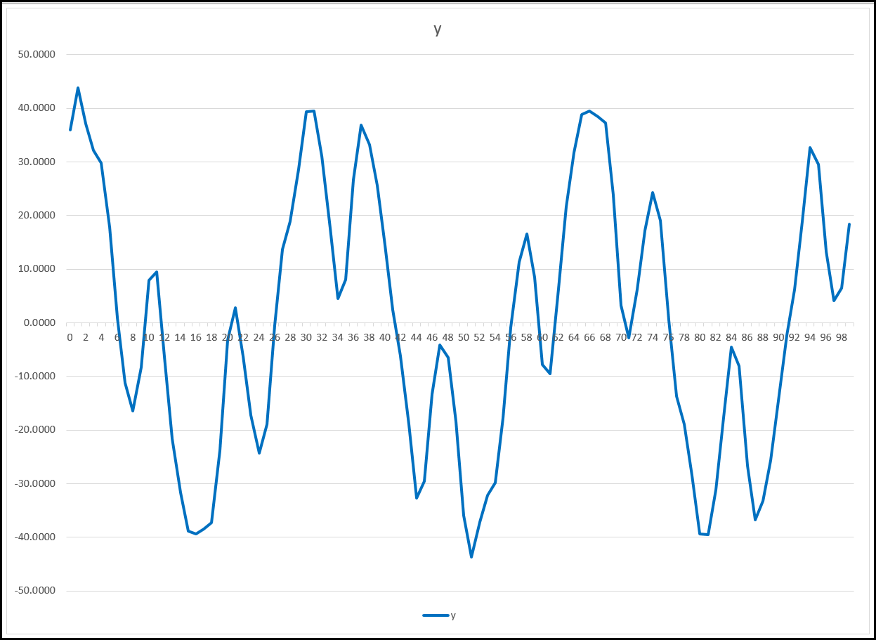
Lab 1 - Generate Samples for Waveform

Slide 27
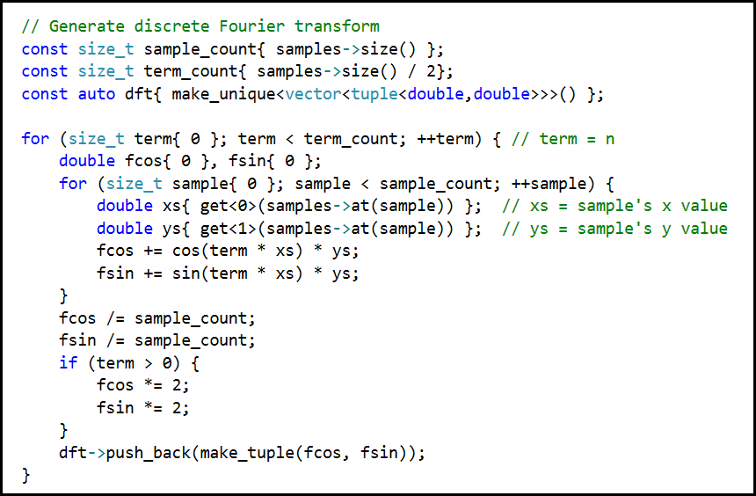
Lab 2 - Generate Discrete Fourier Transform (DFT)

Slide 28
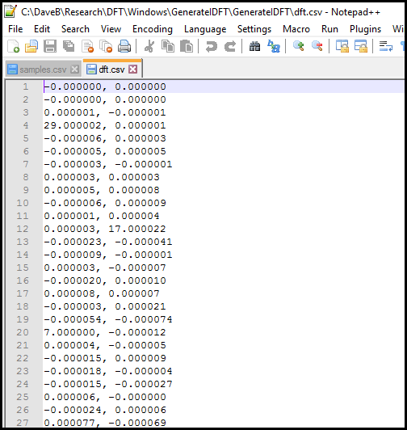
Lab 2 - Generate Discrete Fourier Transform (DFT)
Cosine Amplitudes per Integral Frequency (Row)
Sine Amplitudes per Integral Frequency (Row)

Slide 29
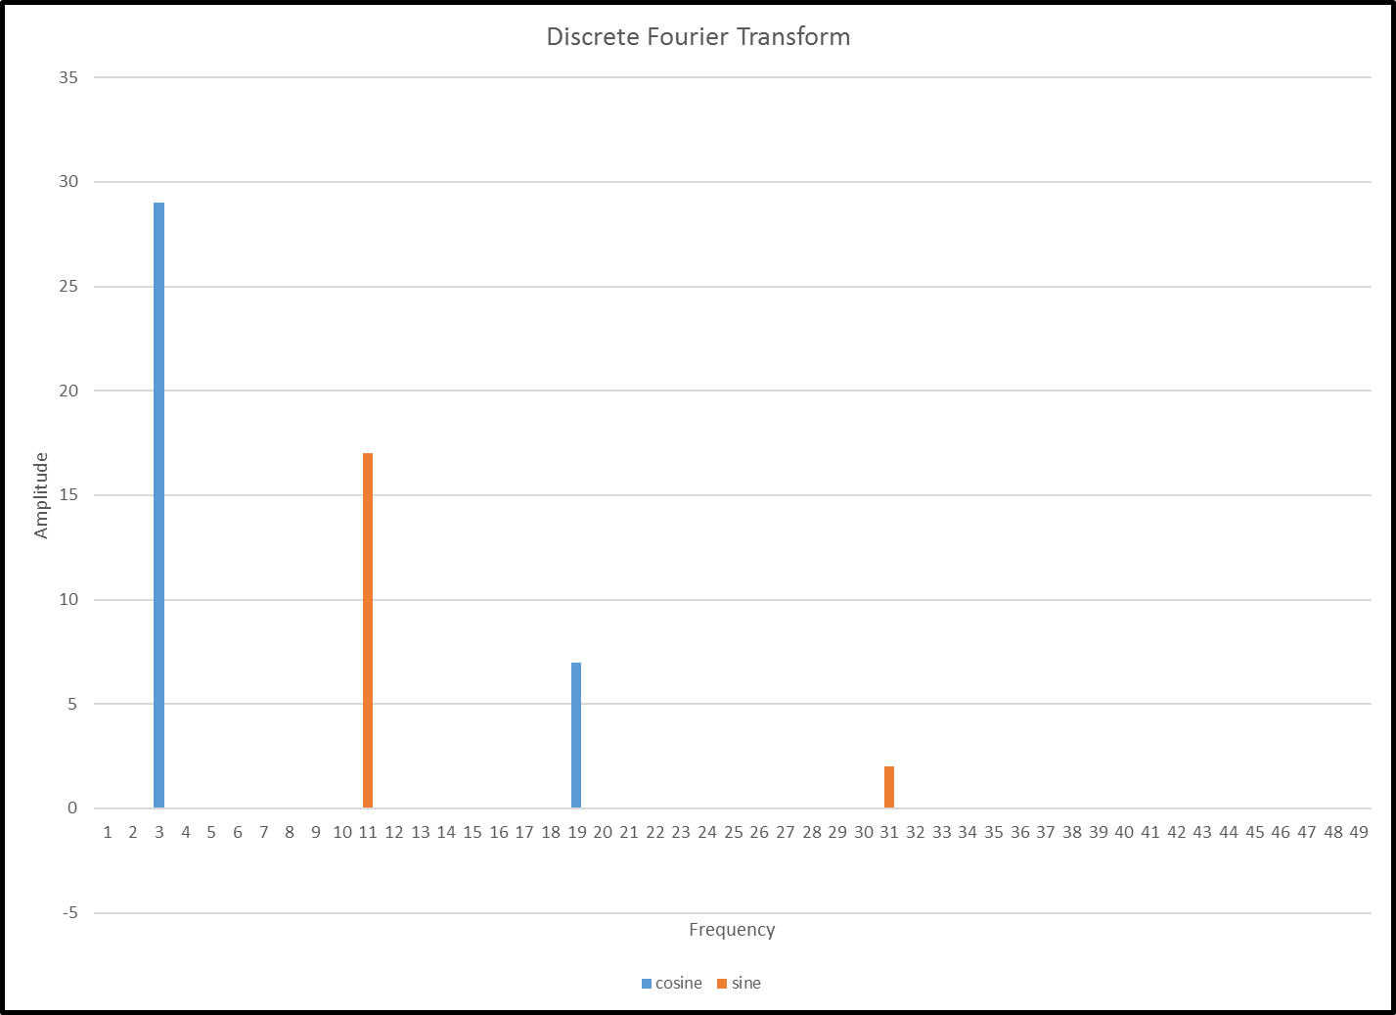
Lab 2 - Generate Discrete Fourier Transform (DFT)
$$y\left(t\right)=29\cos\left(3t\right)+17\sin\left(11t\right)+7\cos\left(19t\right)+2\sin\left(31t\right)$$

Slide 30
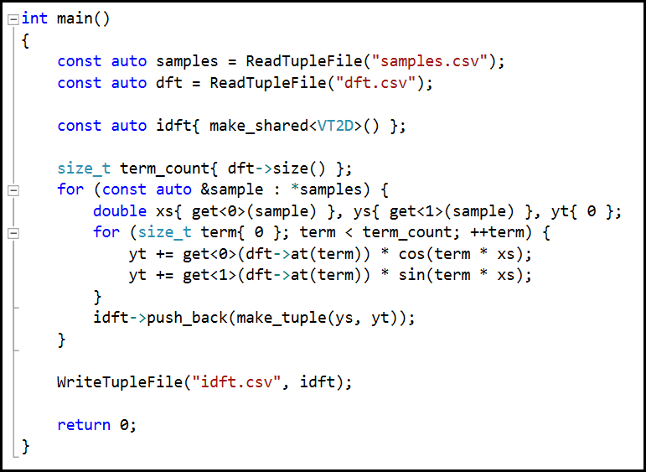
Lab 3 - Generate Inverse Discrete Fourier Transform (IDFT)

Slide 31
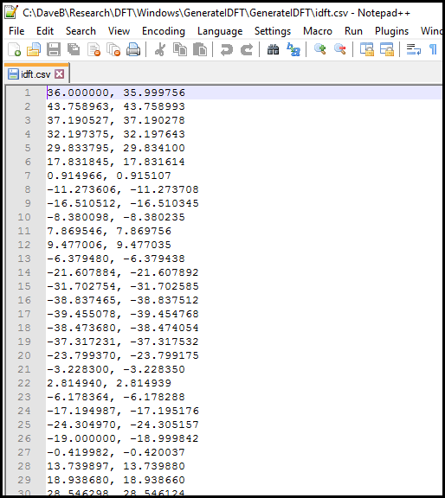
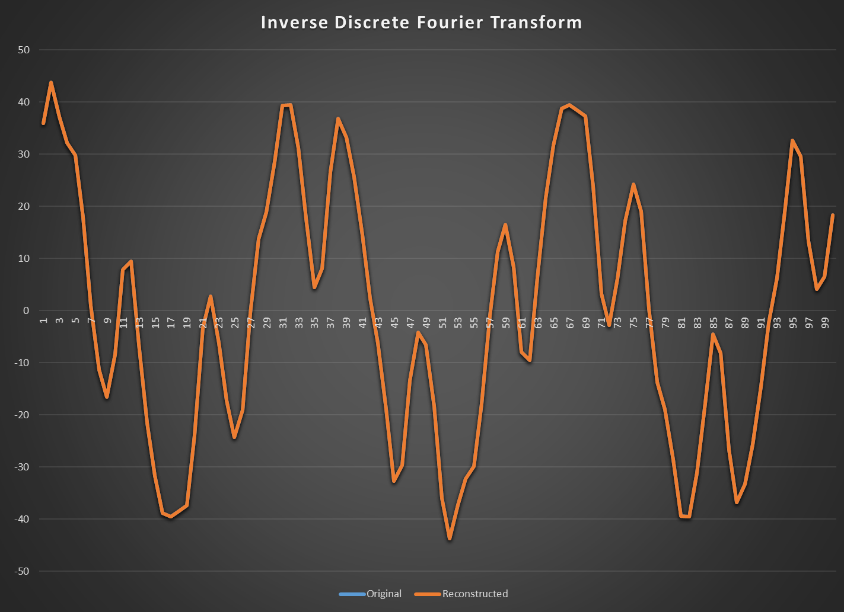
Lab 3 - Generate Inverse Discrete Fourier Transform (IDFT)

Slide 32
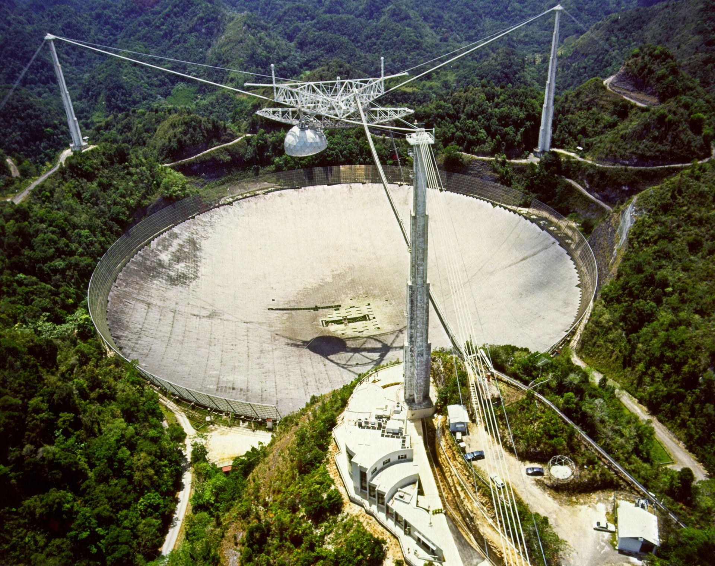
Lab 4 – Analysis of Space Signals
The Arecibo Radio Observatory has detected three candidate signals originating from deep space
Your task is to perform Fourier Analysis on the samples to determine which signal could be broadcast from an extraterrestrial intelligence

Slide 33
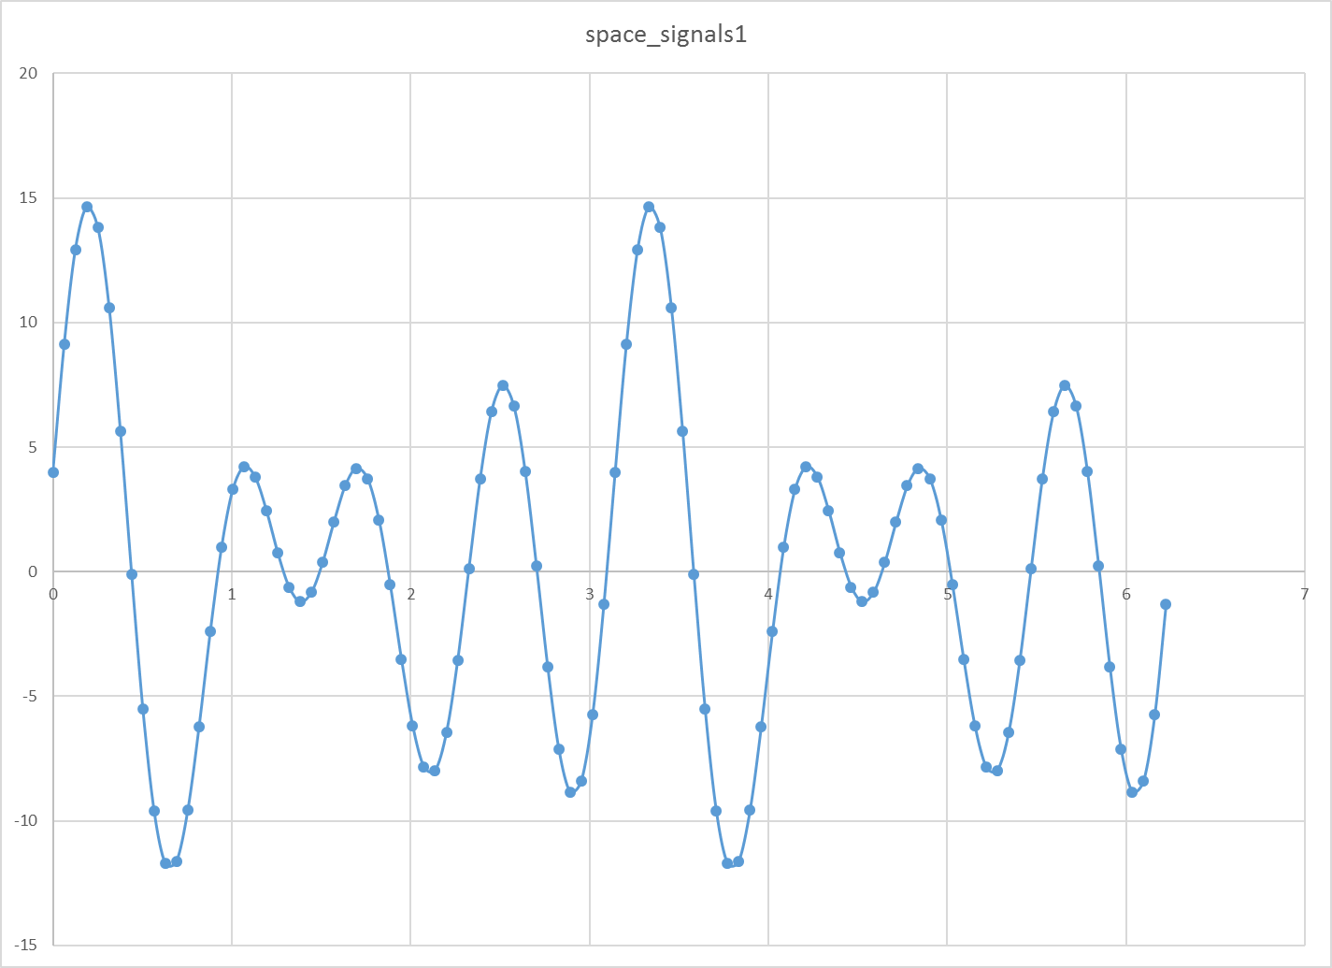

Slide 34
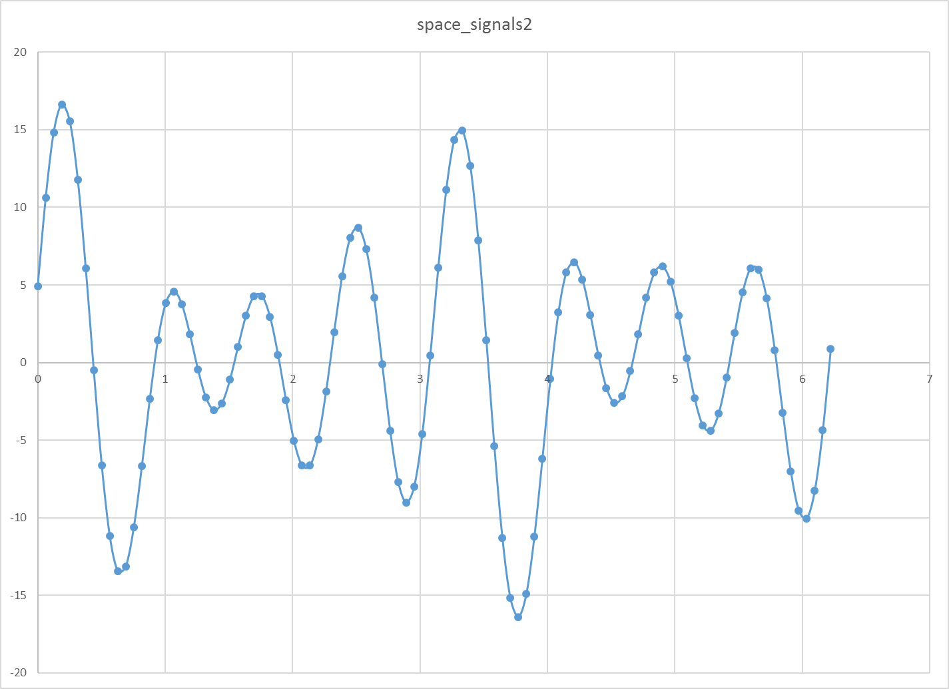

Slide 35
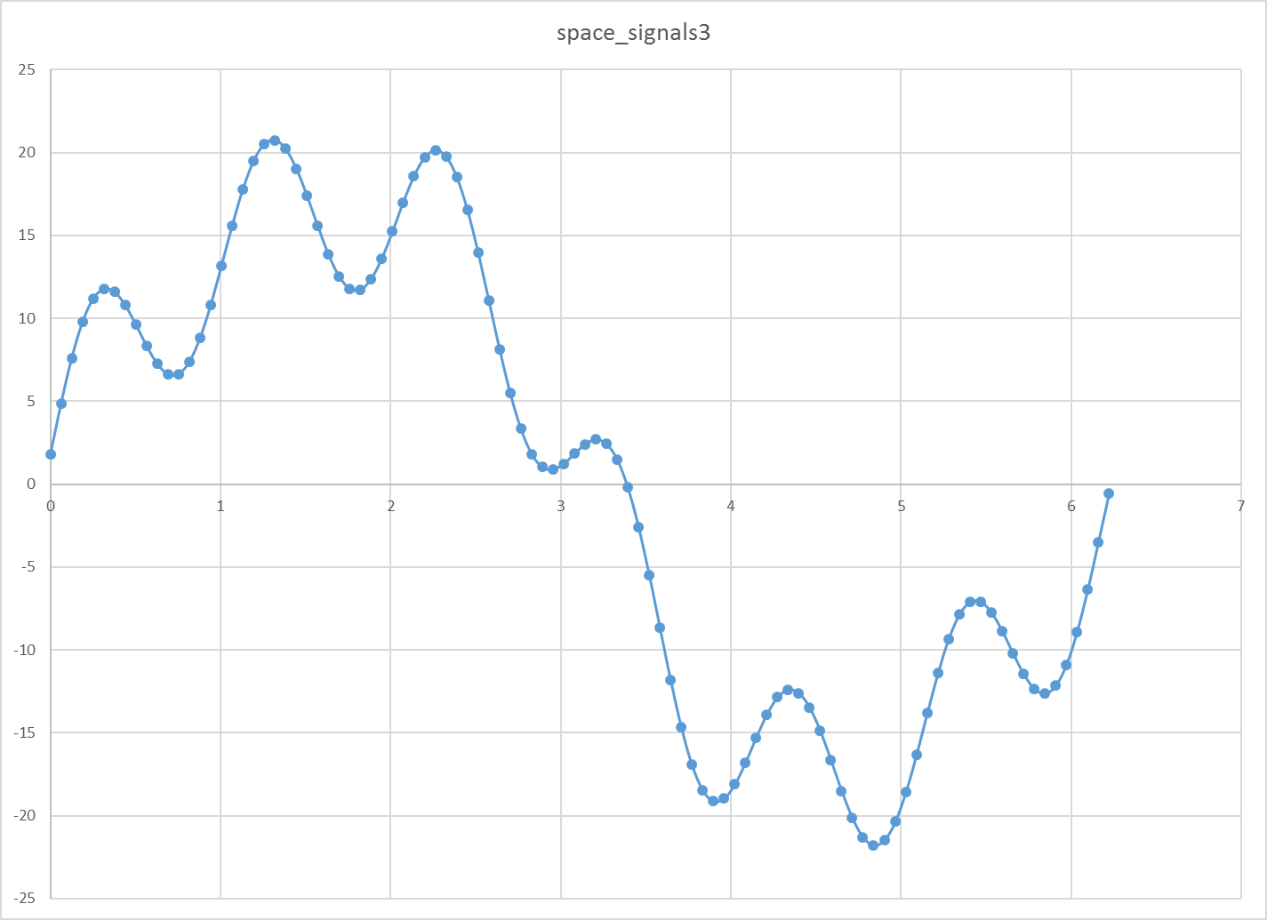

Slide 36
Remaining Topics
Orthogonal Functions
Nyquist Frequency & Aliasing
Euler Identity (Complex Exponentials)
Uncertainty Principle
Higher Dimensional Fourier Transforms (2D)
Discrete Cosine Transform (DCT/JPEG)
Fast Fourier Transform (FFT)

Slide 37
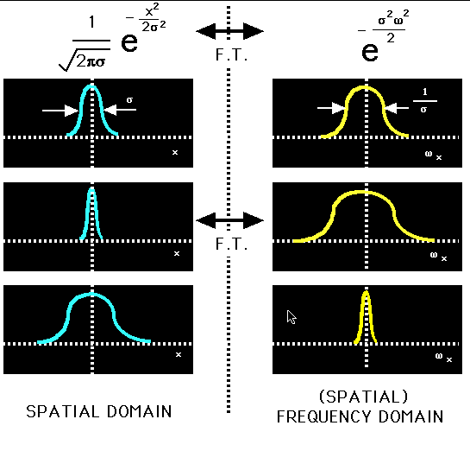
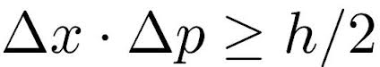
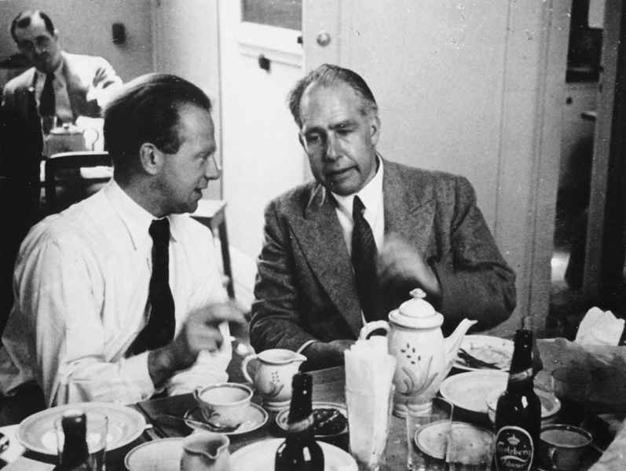
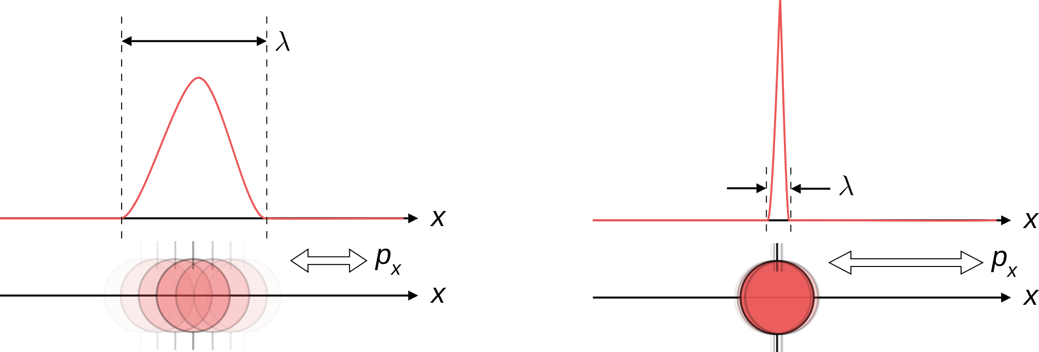
Heisenberg Uncertainty Principle

Slide 38
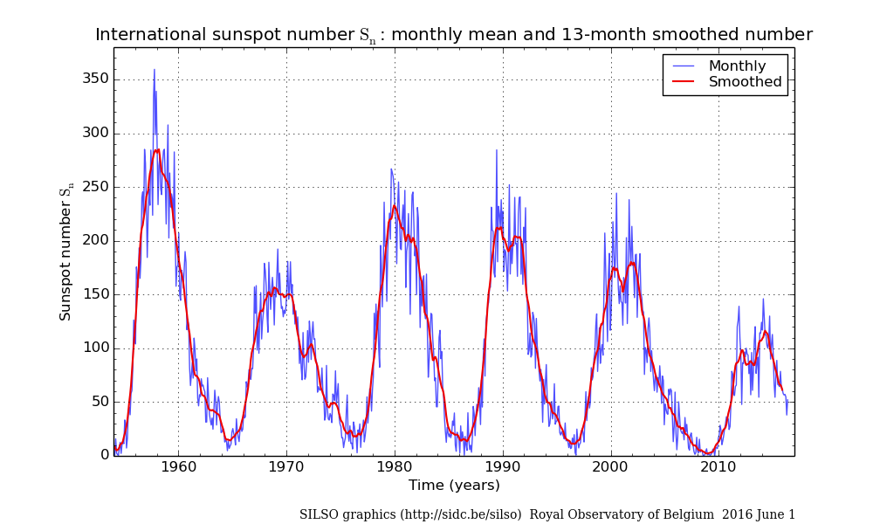

Slide 39
Now you know…
Fourier Analysis is the process of determining the amplitudes and wavelengths of the constituent simple harmonics of a complex waveform
In the discrete transform, we sample a waveform at specific time slices (the time domain) to determine the coefficients of in the frequency domain
What appears to be a complex waveform in the time domain might have a simple underlying Fourier representation in the frequency domain
Discrete Fourier Transform (DFT) can provide insight in the character of the physical law generating the wave

